Slide 1


DilDil Kids Art
Capstone 1 - Project Presentation
Date : 4/2/2020
Presenter : Huseyin Korkmaz

Slide 2
About YouTube variables
Video Impressions: Impressions are the number of times your content is displayed by YouTube, no matter if it was clicked or not. (#)
CTR: Impressions click-through rate. (%)
Watch Time: Total watch time of a video. (h)
Ad Impressions: An impression is when an ad is fetched from its source and is countable. Whether the ad is clicked is not taken into account. Each time an ad is fetched, it is counted as one impression. (#)
CPM: Cost-per-mille; the average gross revenue per thousand served ad impressions. ($)
Success Event Classification – We classified videos that earned at least $40 in ad revenue as "Successful" and others as "Unsuccessful" and compare them on variables.
Formula of Ad Revenue - YouTube advertisement revenue formula is: Ad Revenue = Ad Impressions/1000 x CPM.

Slide 3
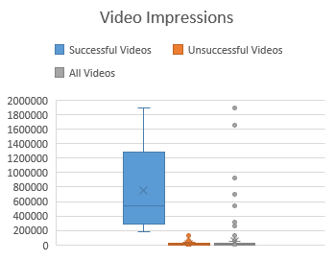
A ‘Successful Event’ on the Ad Revenue is strongly correlated with Video Impressions that affect the number of views, and CPM rates that seem to move in opposition to the revenue rates contrary to the fact of more CPM rates cause more Ad Revenue.
Key Insights
Video Impressions – Video Impression seems to be the main criterion when the variables of successful and unsuccessful videos are compared. Click-through Rate (CTR) and Watch Time are strongly related to Video Impressions. DilDil Kids Art can pay more attention to produce the thumbnails and contents more attractive and related to their topics to increase CTR and Watch Time.
CPM – CPM does not appear to be a criterion variable between successful and failed events, but it directly affects ad revenue. Since CPM is related to Geography and Ad Type, improvements to these options may affect Ad Revenue positively. DilDil Kids Art can add video language and translations of subtitles to spread video impressions to some geographies where have high-rate CPM and turn on ‘Non-Skippable Ads’ option to get more CPM rate and Ad Revenue.
* Video Impressions: Impressions are the number of times your content is displayed by YouTube, no matter if it was clicked or not. * CPM: Cost-per-mille; the average gross revenue per thousand served ad impressions.
Source: DilDil Kids Art’s Google Analytics data 2019

Slide 4
Ad Revenue
According to the criteria of $40 success limit, there are 9 "Successful Videos" which have 78% of all ad revenue and 197 "Unsuccessful Videos" which have lower video impressions.
Success Event Classification – We classified videos that earned at least $40 in ad revenue as "Successful" and others as "Unsuccessful" and compare them on variables.
Formula of Ad Revenue - YouTube advertisement revenue formula is: Ad Revenue = Ad Impressions/1000 x CPM Therefore, CPM is exactly related to Ad Revenue, no matter if it is a 'successful' event or not.
* Ad Impressions: An impression (in the context of online advertising) is when an ad is fetched from its source and is countable. Whether the ad is clicked is not taken into account. Each time an ad is fetched, it is counted as one impression.
Source: DilDil Kids Art’s Google Analytics data 2019

Slide 5
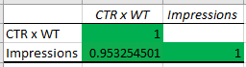
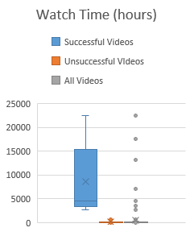
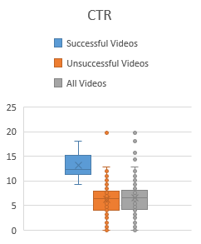
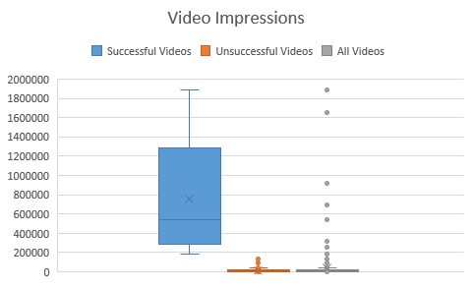
Video Impressions
When the variables of successful and unsuccessful events are compared, Video Impressions, Watch Time and CTR are seen as the determining criteria. This shows that the thumbnails and contents of the ‘Successful’ videos are more attractive and related to their topics than ‘Unsuccessful’ videos'.
Correlations – With respect to the Correlation Matrix, it looks (CTR x Watch Time) strongly correlated with Video Impressions.
Watch Time increases when the content of the video is attractive, fluent and related to the topic.
CTR increases when the thumbnail of the video is attractive.
* CTR: Impressions click-through rate
Source: DilDil Kids Art’s Google Analytics data 2019

Slide 6
CPM
No matter if it is a 'successful' event or not, CPM rates seem to move in opposition to the revenue rates contrary to the formula of {Ad Revenue = Ad Impressions/1000 x CPM}.
During the two points of the highest revenue, CPM has the lowest rates.
CPM depends on the price of the ads which are shown on the watch page. YouTube own determines which ad would be shown on the page. But some variables -such as ad type and geography- can affect CPM rates.
* CPM: Cost-per-mille; the average gross revenue per thousand served ad impressions.
Source: DilDil Kids Art’s Google Analytics data 2019

Slide 7
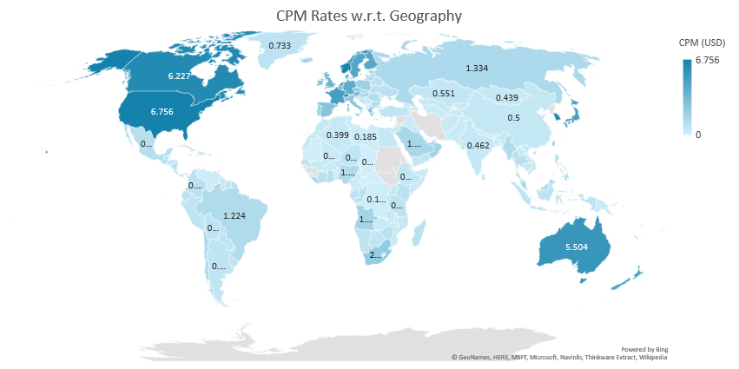
CPM - Geography
While DilDil Kids Art’s total average CPM is $2.581, its CPM rates are between $3.5 and $6.5 in some countries such as the US, Norway, Canada, South Korea, etc. This shows that adding video language and translations of subtitles can spread video impressions to some geographies which have high-rate CPM.
CPM rates change according to the countries. YouTube determines videos would be shown in which country. But some options -such as video language, translations of subtitles- can affect the video impressions' geography.
Source: DilDil Kids Art’s Google Analytics data 2019
7

Slide 8
CPM - Ad Type
Display Ads are the most common (52%) ad type, however, they have a lower rate (21%) of revenue. Non-Skippable Ads which is subject to permission to be shown by the channel manager have a high CPM rate (3.8$) but don’t have any impression rate.
CPM rates change according to the Ad Types.
The impression of ‘Non-Skippable Ads’ is up to channel manager (content creator).
Turning on ‘Non-Skippable Ads’ option can affect the channel’s CPM rate positively.
Source: DilDil Kids Art’s Google Analytics data 2019
8

Slide 9
Conclusion and Recommendations
There are 2 main variables that directly affect Ad Revenue; Video Impressions and CPM.
Increasing Video Impressions
CTR and Watch Time are strongly related to Video Impressions.
Increasing CPM Rate
Ad Type and Geography are related to CPM.
We strongly recommend DilDil Kids Art should
Pay more attention to produce the thumbnails and contents more attractive and related to their topics to increase CTR and Watch Time.
Add video language and translations of subtitles to spread video impressions to some geographies where have high-level CPM.
Turn on ‘Non-Skippable Ads’ option to get more CPM rate and Ad Revenue.
CPM: Cost-per-mille; the average gross revenue per thousand served ad impressions.
CTR: Impressions click-through rate
9

